Slide 1
Introduction to Machine Learning
Trinh Nguyen Quoc
2017 – 09 – 07
nguyenquoctrinhctt3@gmail.com

Slide 2
Agenda

Slide 3
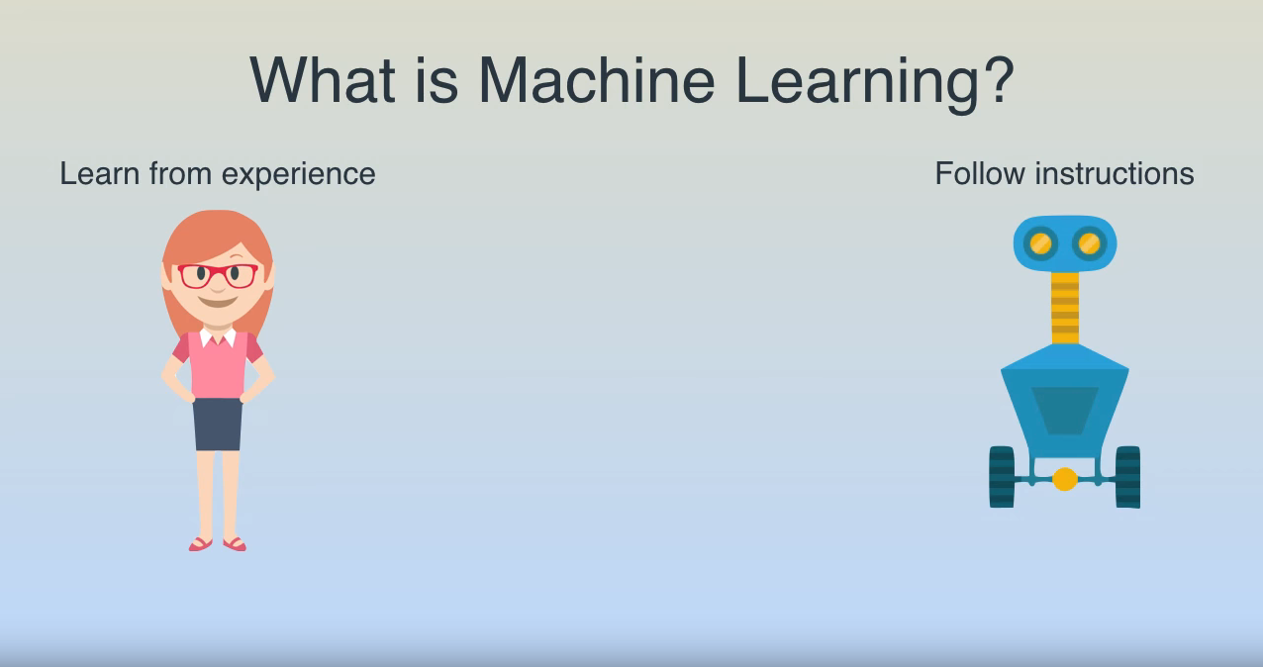
What is Machine Learning

Slide 4
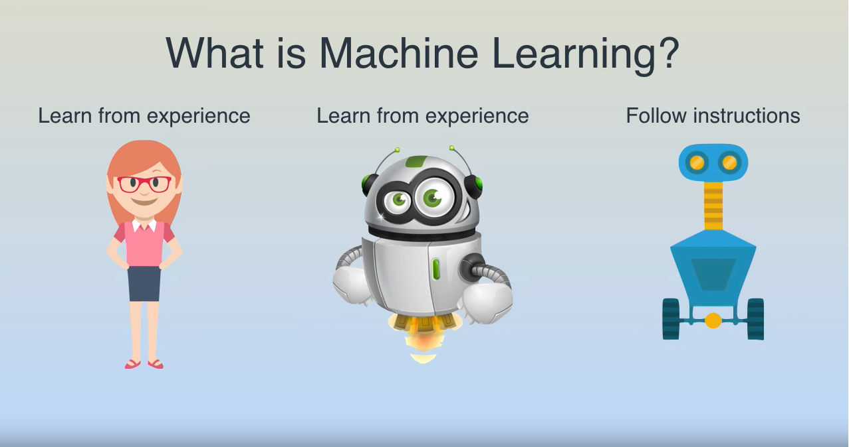
What is Machine Learning

Slide 5
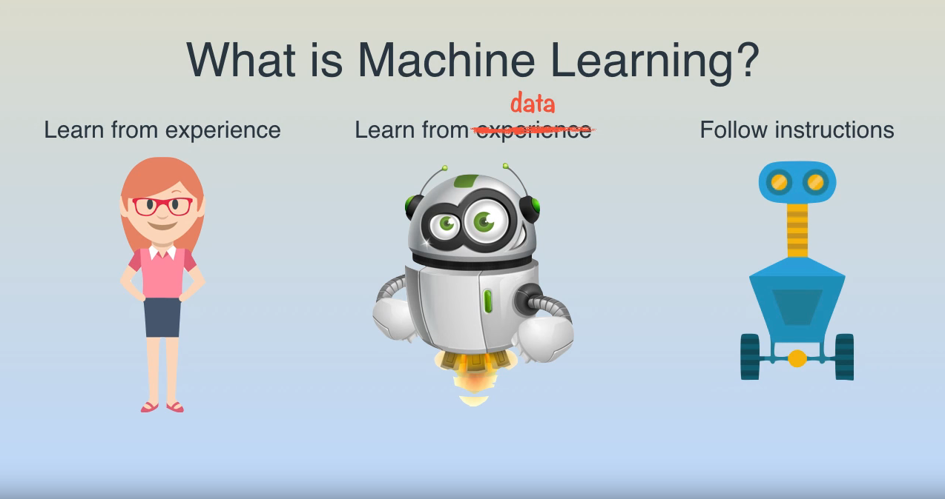
What is Machine Learning

Slide 7
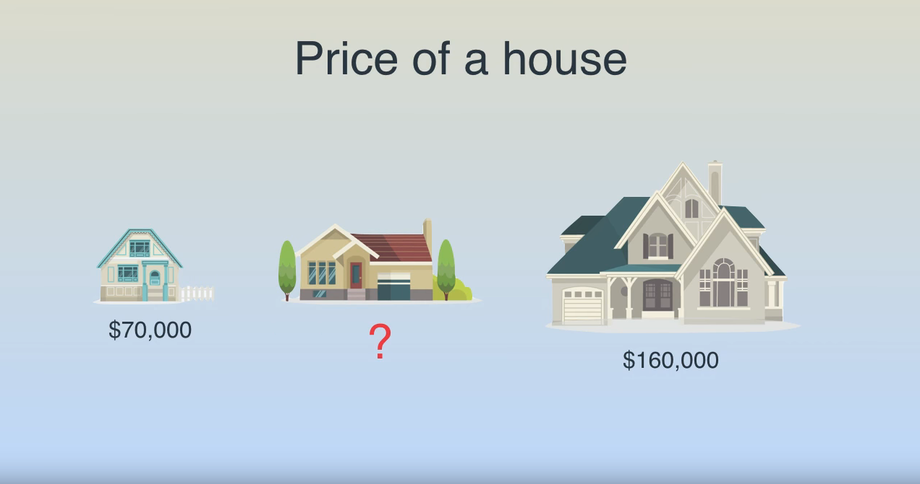
Example

Slide 8
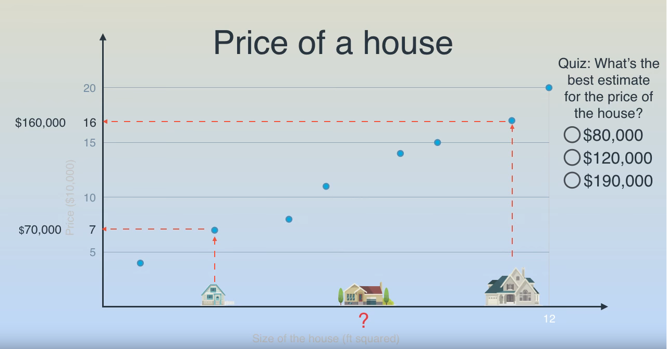
Example

Slide 9
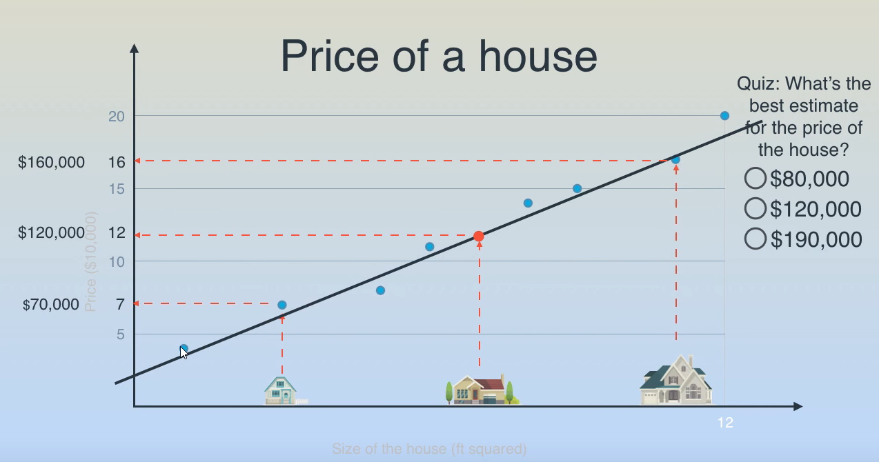
Example

Slide 10
Example

Slide 11
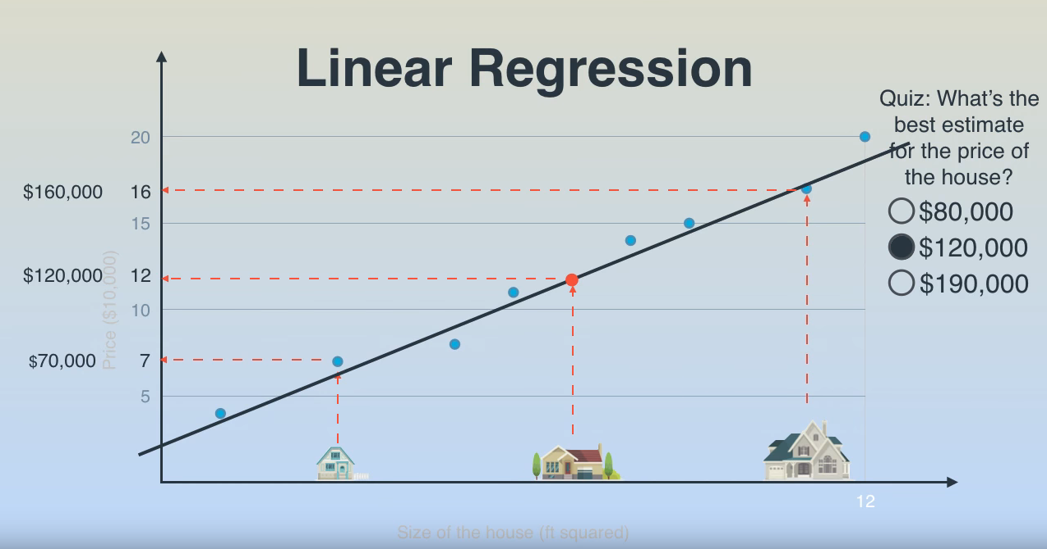
Example

Slide 12
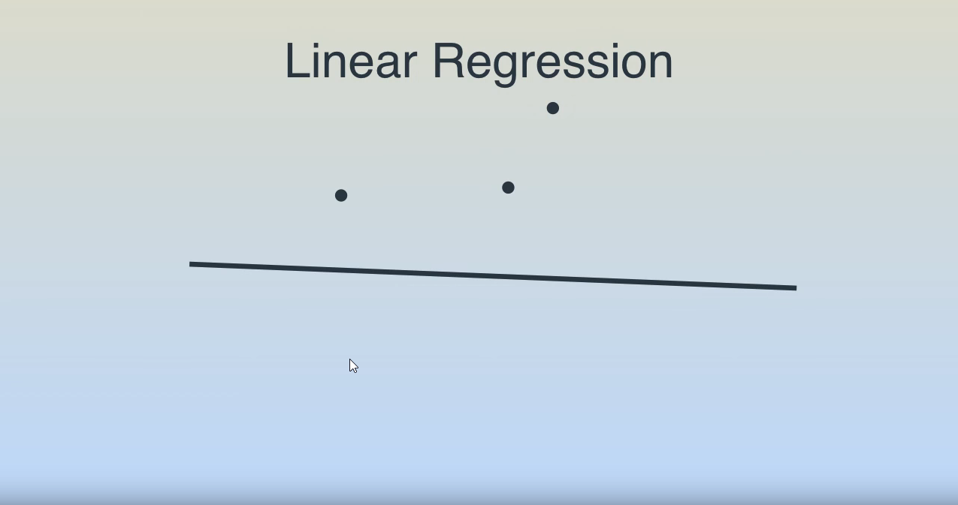
Linear Regression

Slide 13
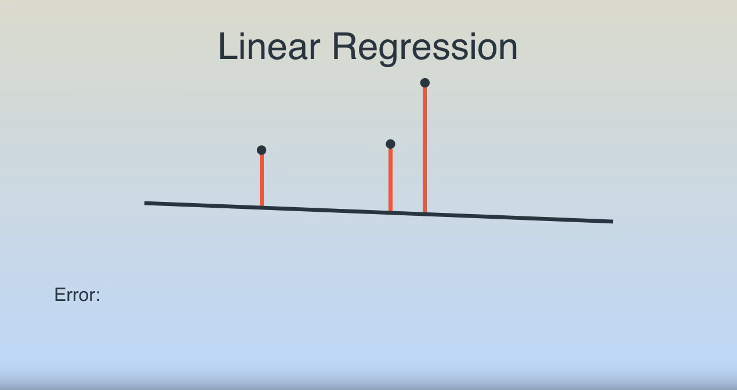
Linear Regression

Slide 14
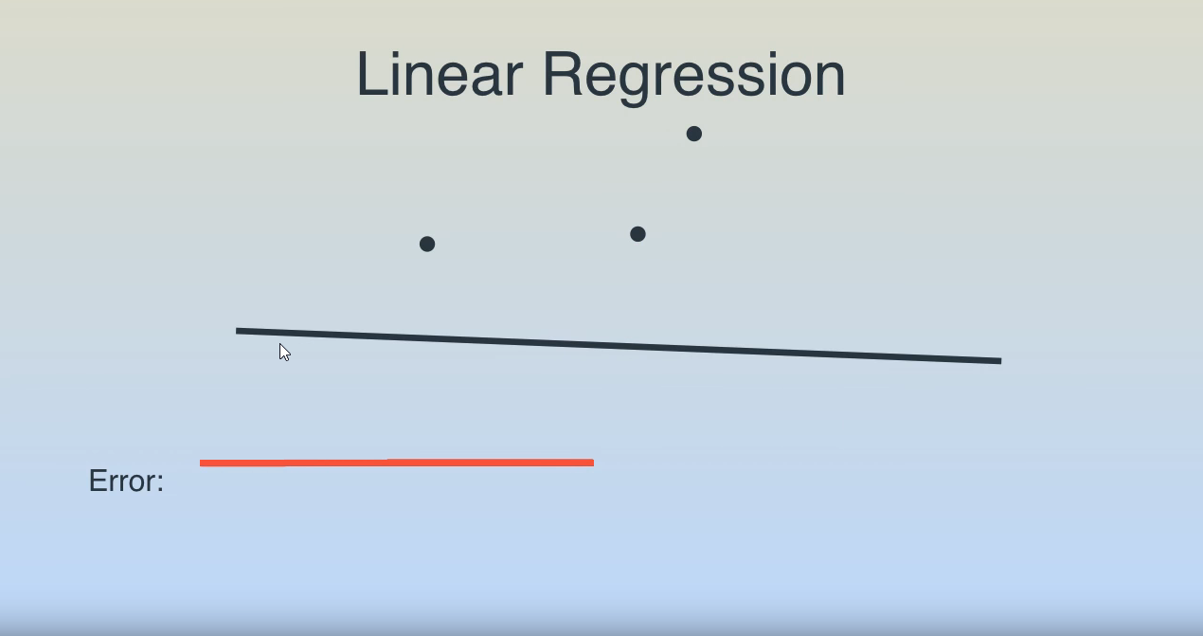
Linear Regression

Slide 15
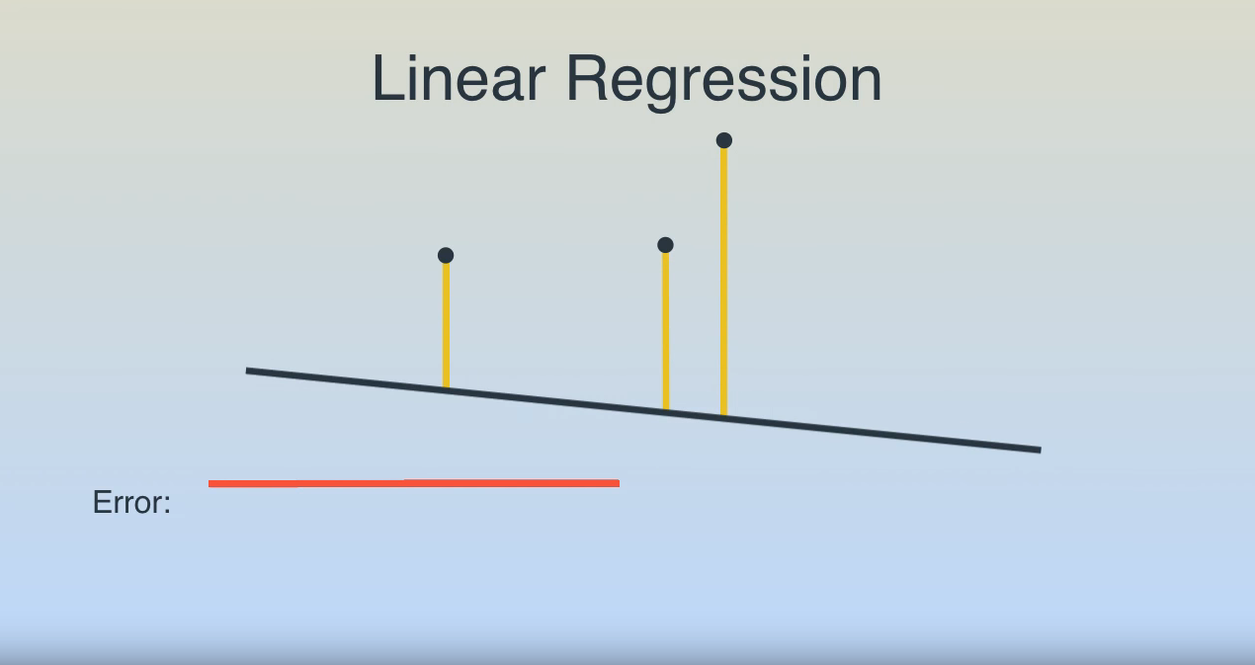
Linear Regression

Slide 16
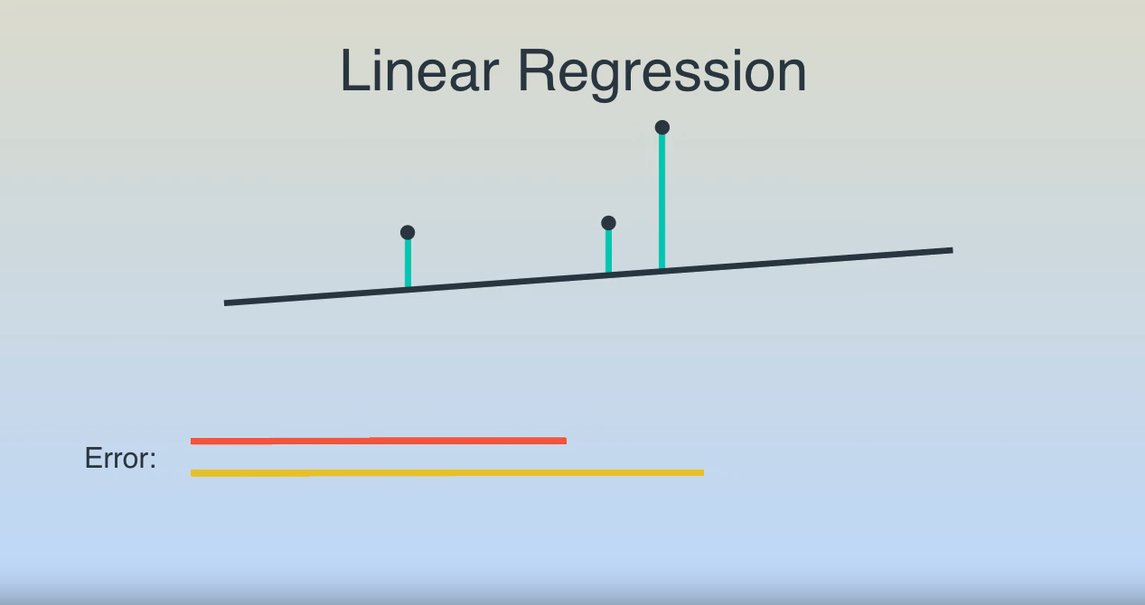
Linear Regression

Slide 17
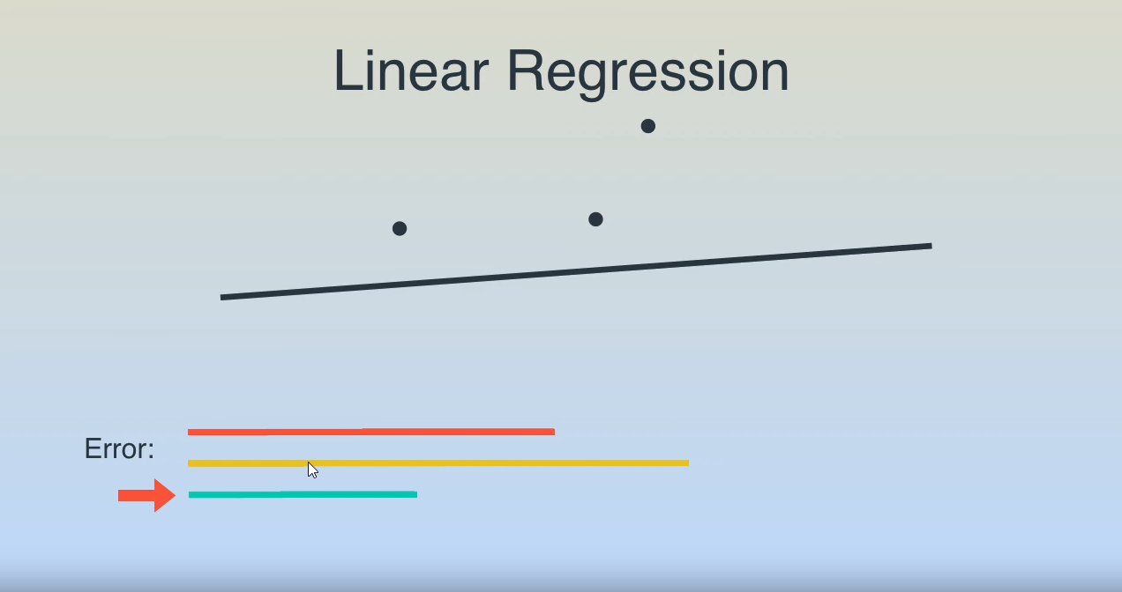
Linear Regression

Slide 18
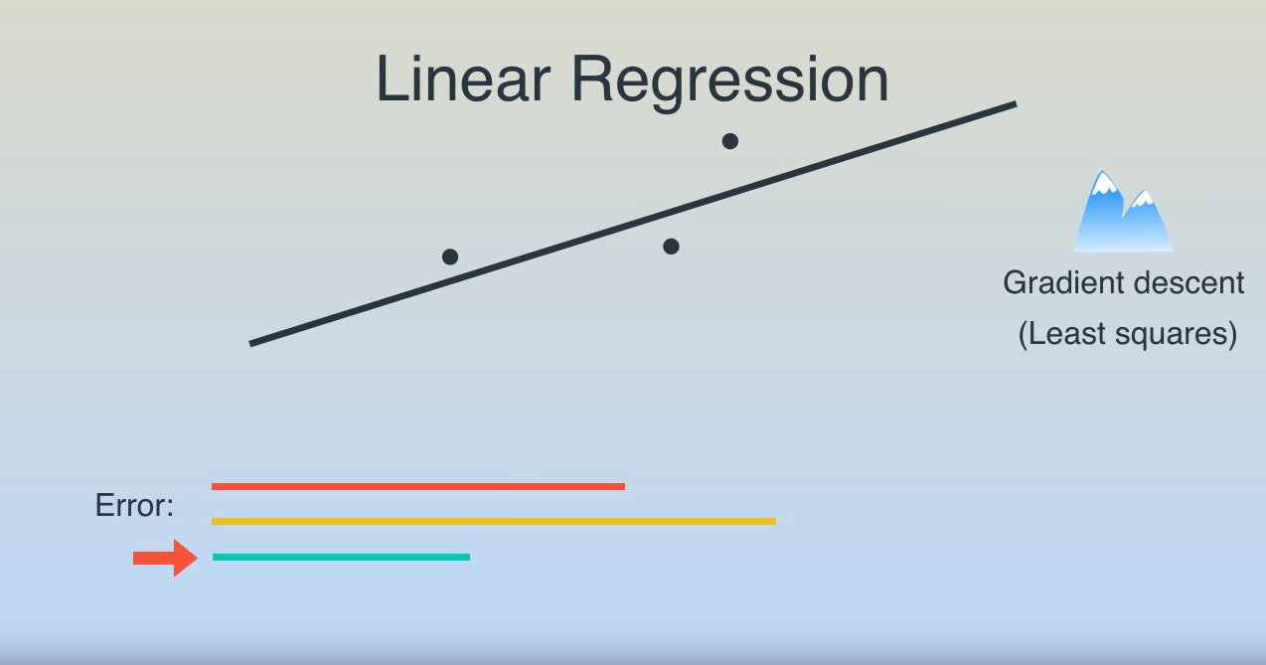
Linear Regression

Slide 19
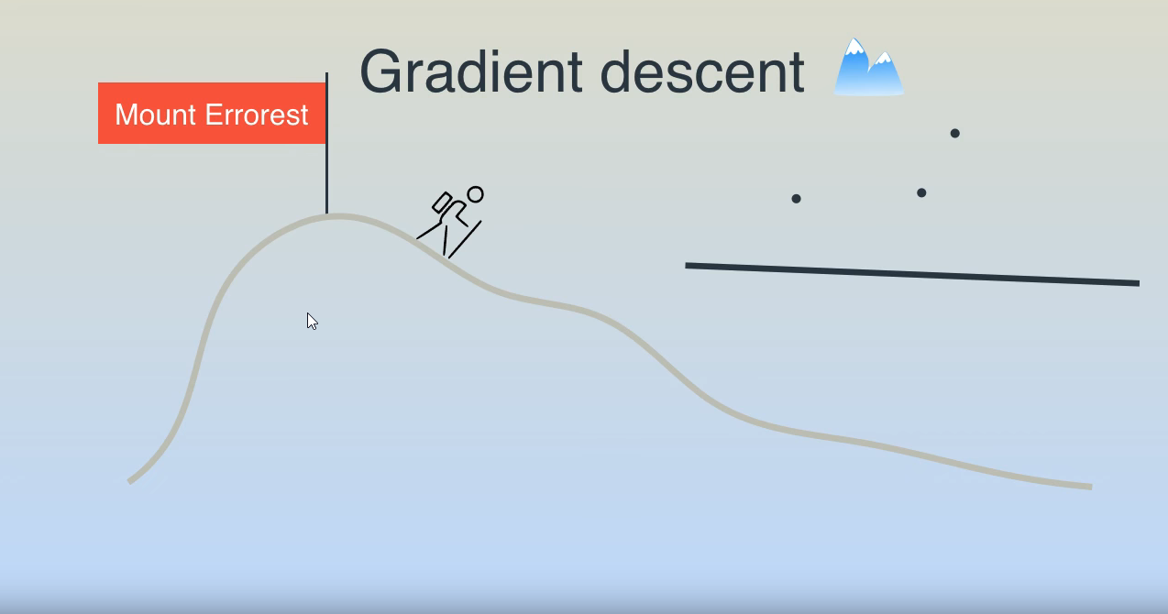
Linear Regression

Slide 20
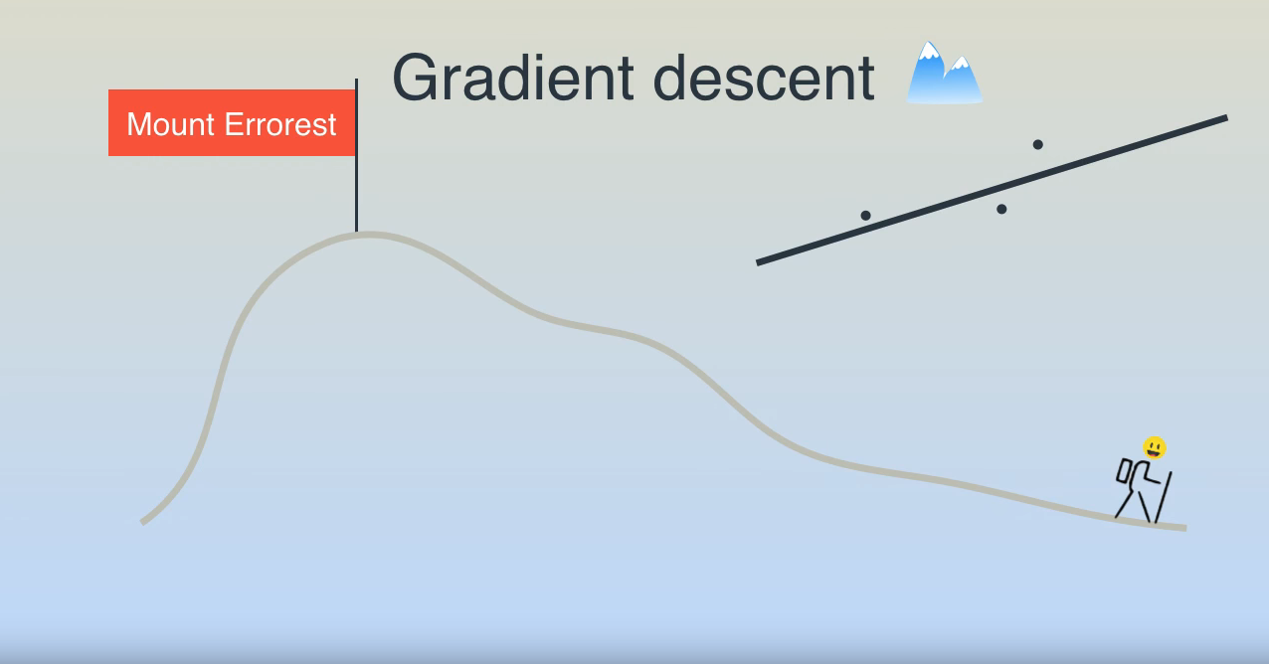
Linear Regression

Slide 21
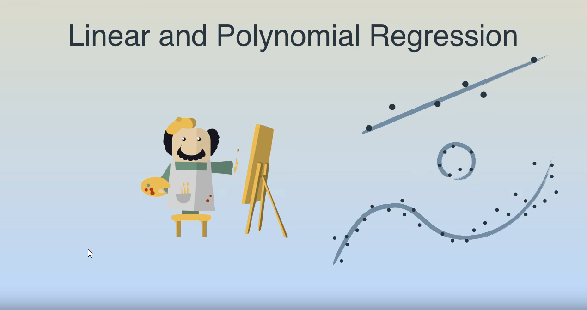
Linear and Polynomial Regression

Slide 22
Linear Regression

Slide 23
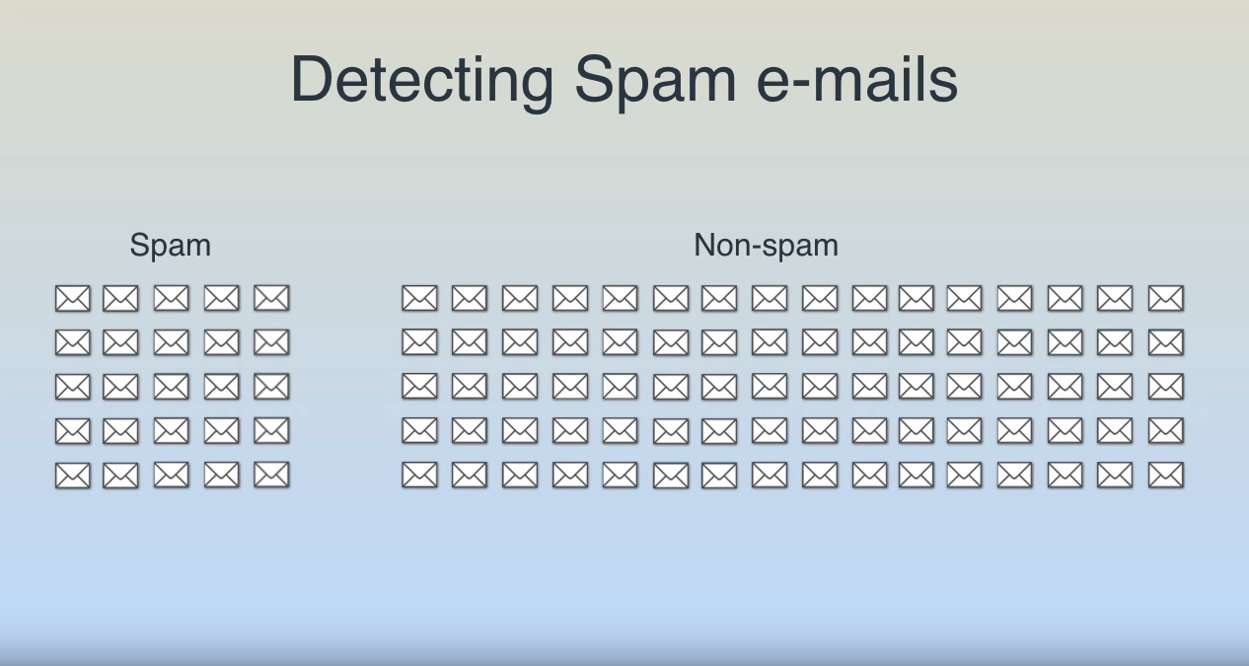
Example

Slide 24
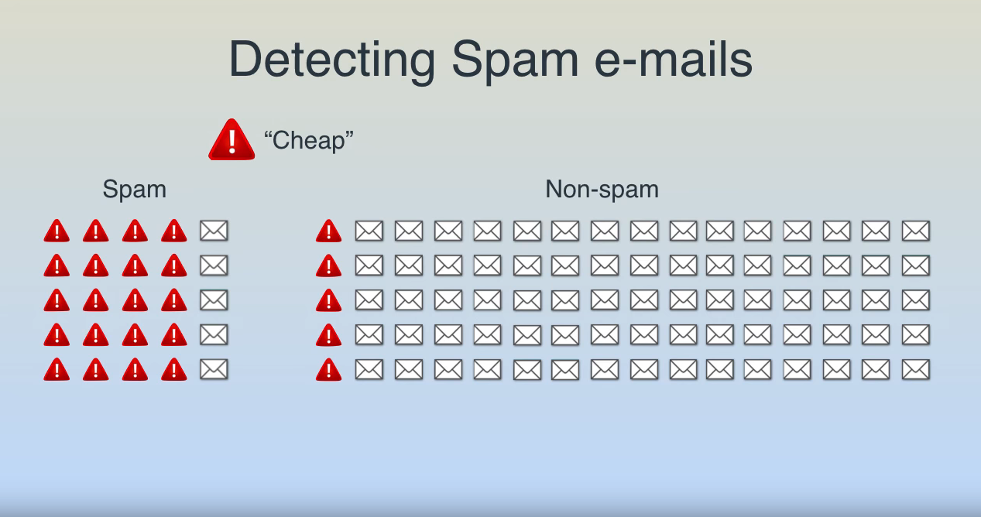
Example

Slide 25
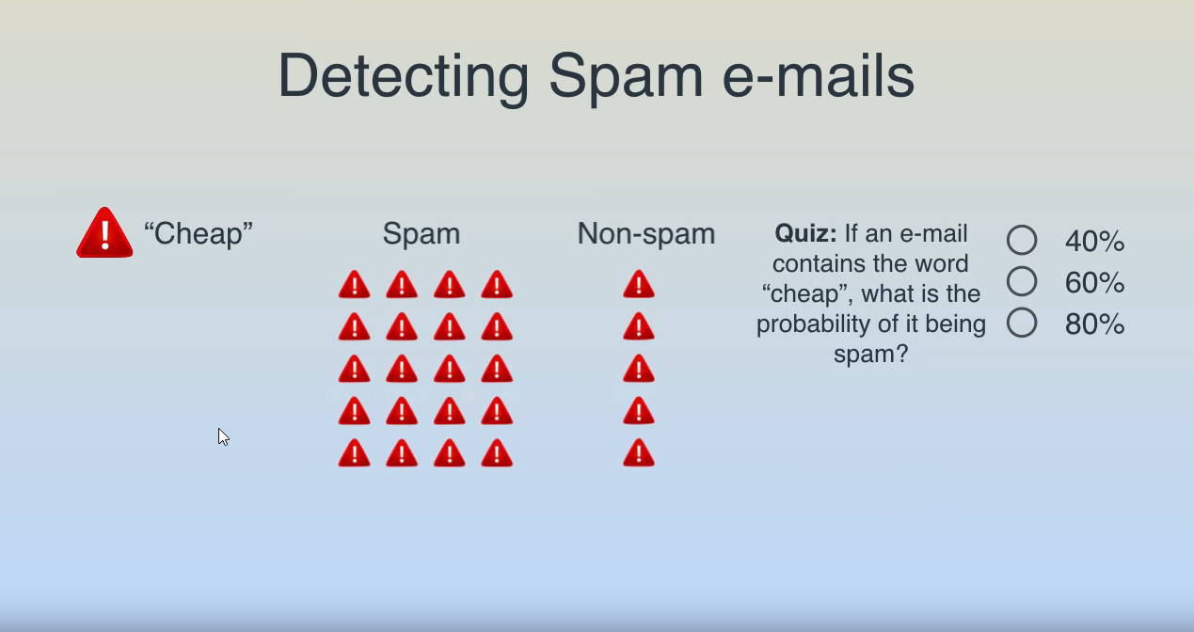
Example

Slide 26
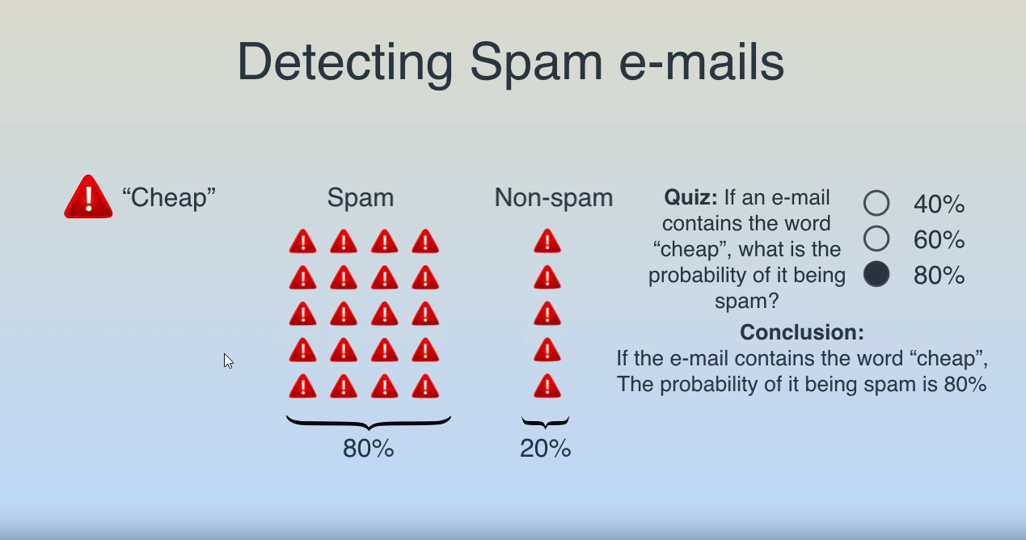
Example

Slide 27
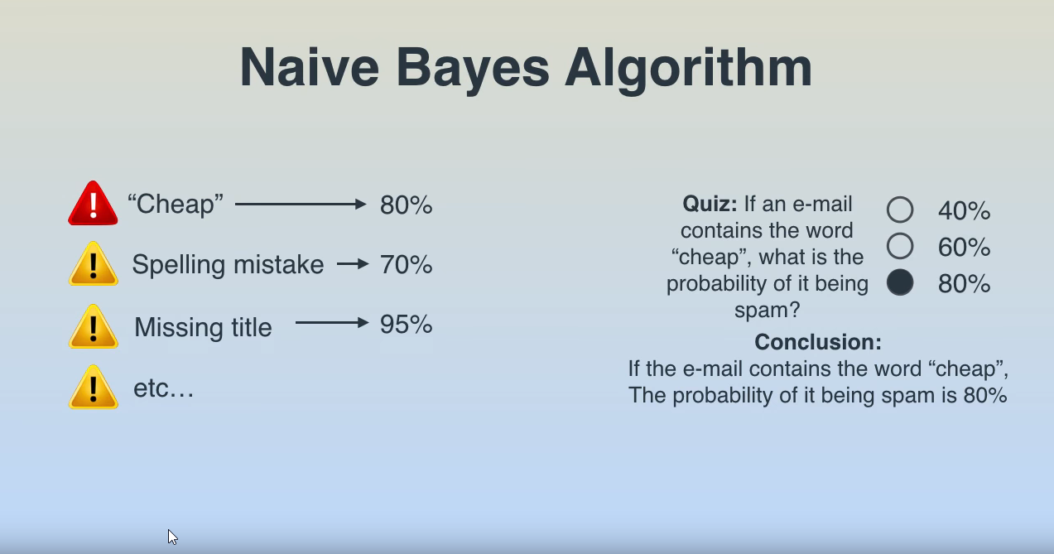
Naïve Bayes Algorithm

Slide 28
Example

Slide 29
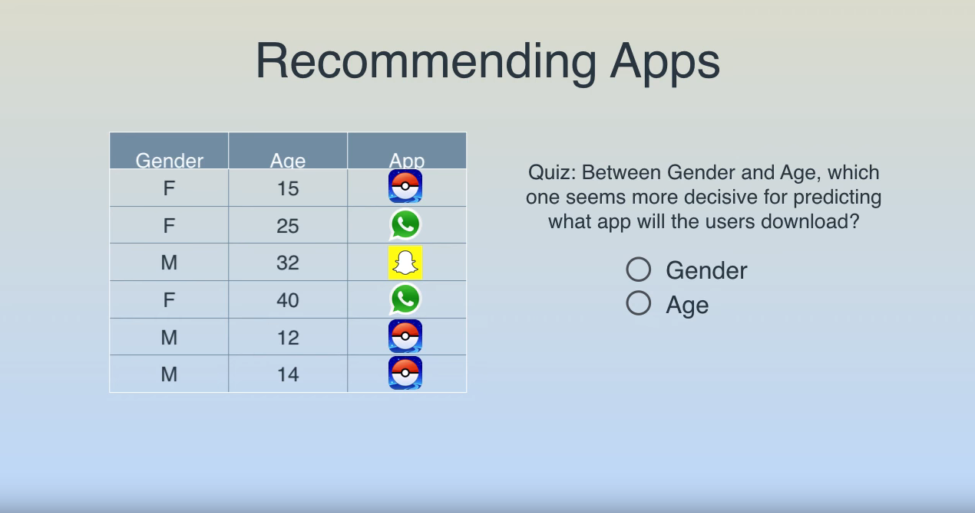
Example

Slide 30
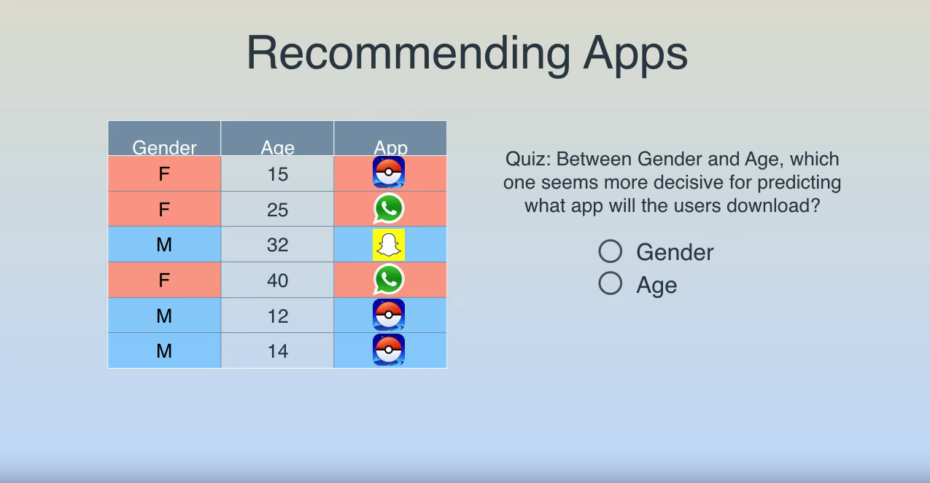
Example

Slide 31
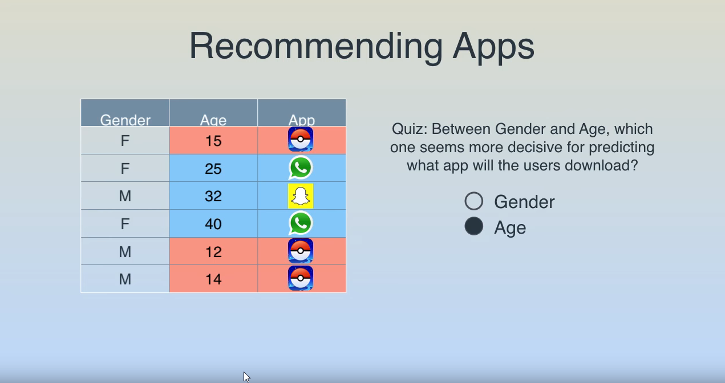
Example

Slide 32
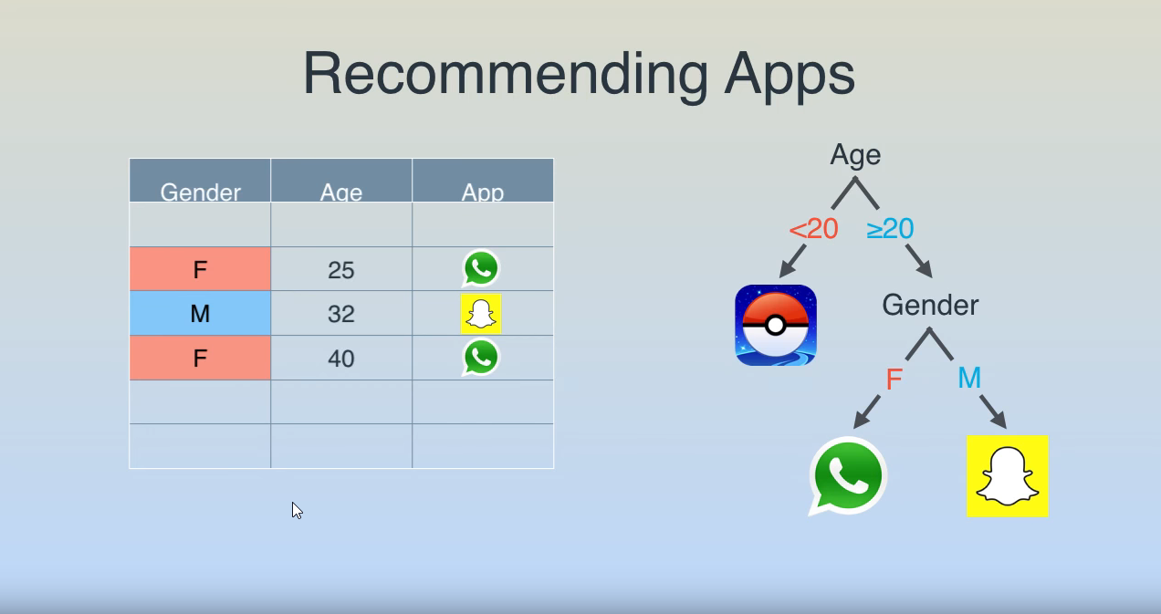
Example

Slide 33
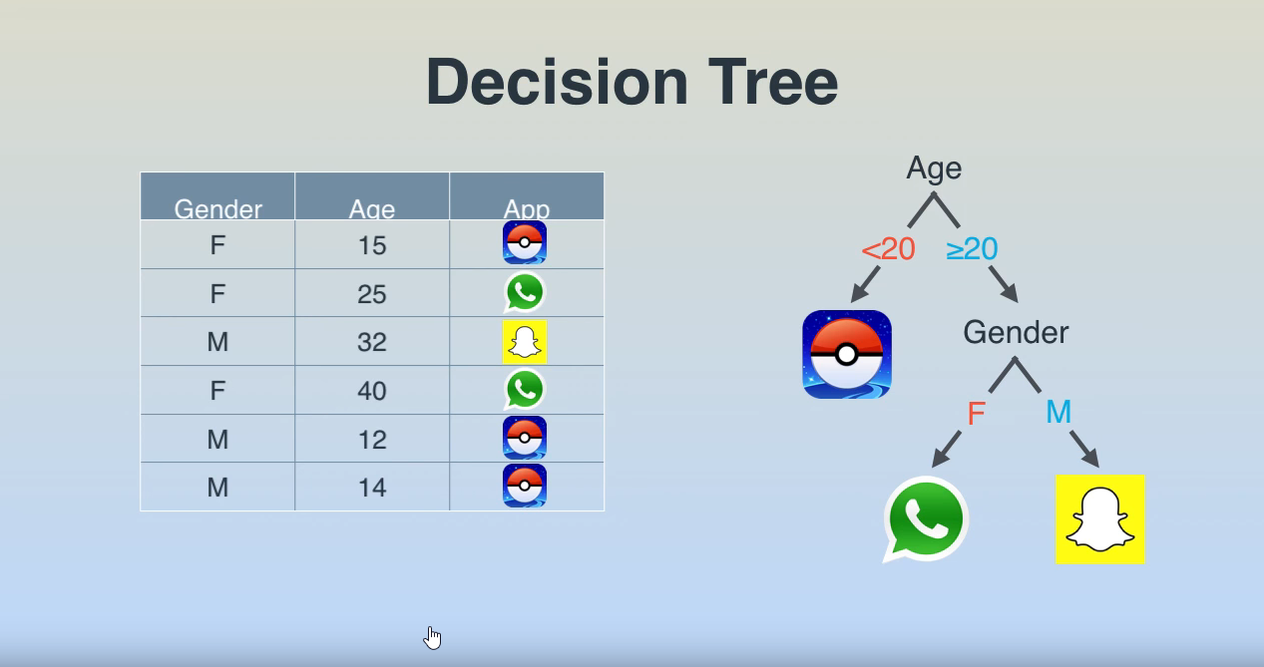
Decision Tree

Slide 34
Example

Slide 35
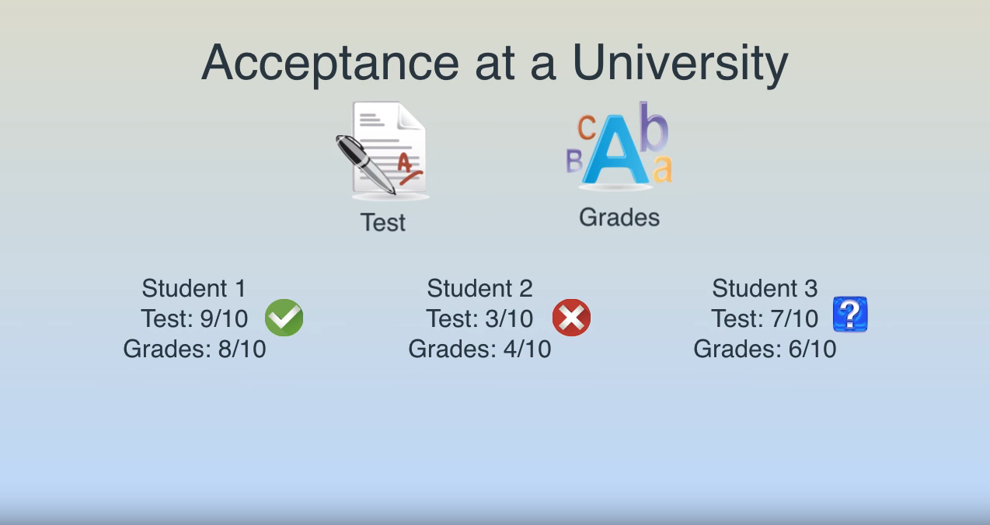
Example

Slide 36
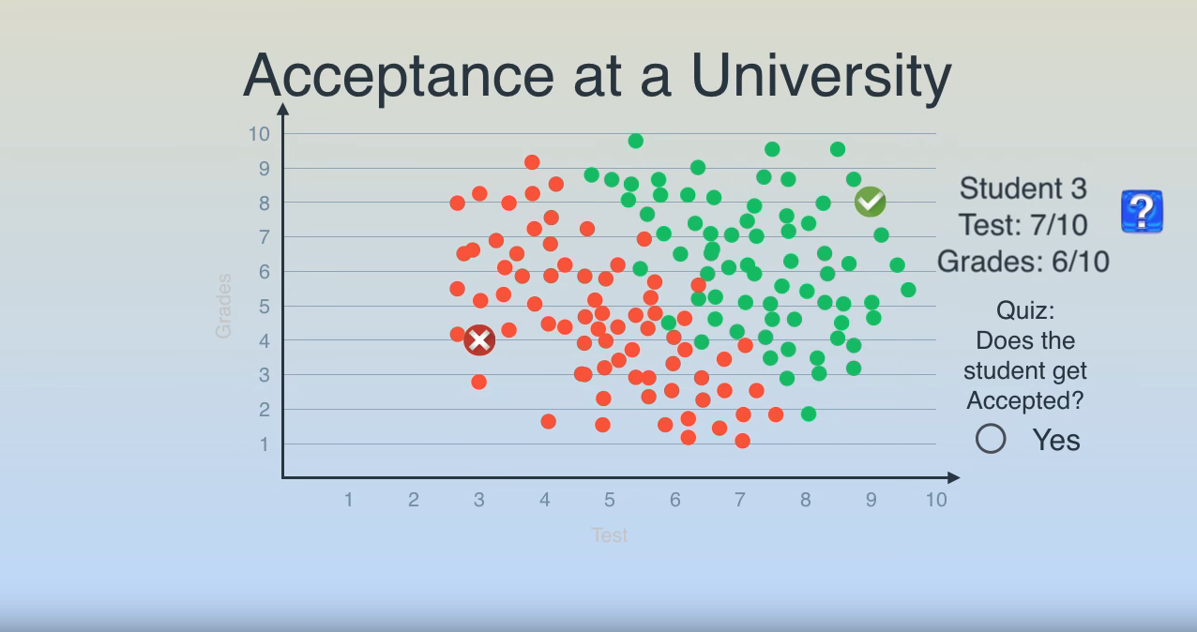
Example

Slide 37
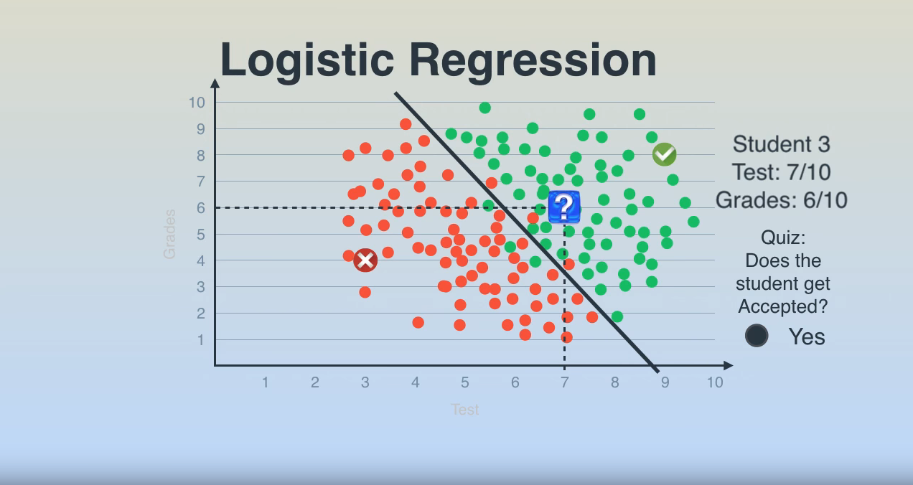
Logistic Regression

Slide 38
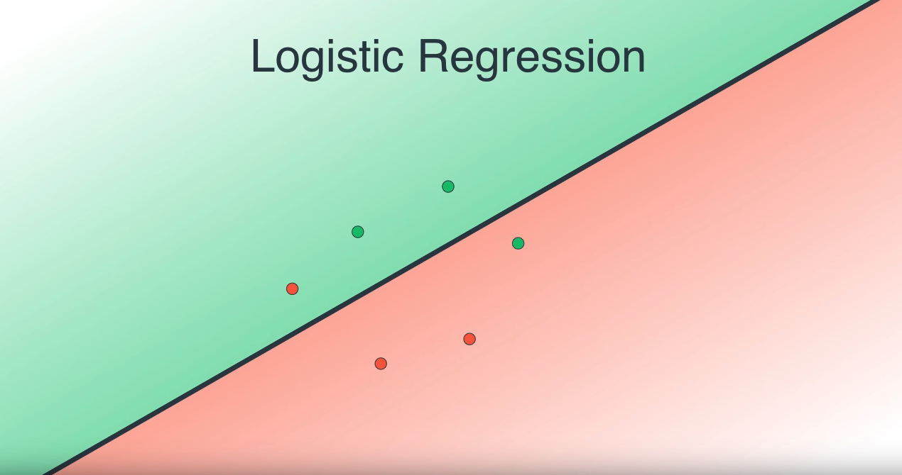
Logistic Regression

Slide 39
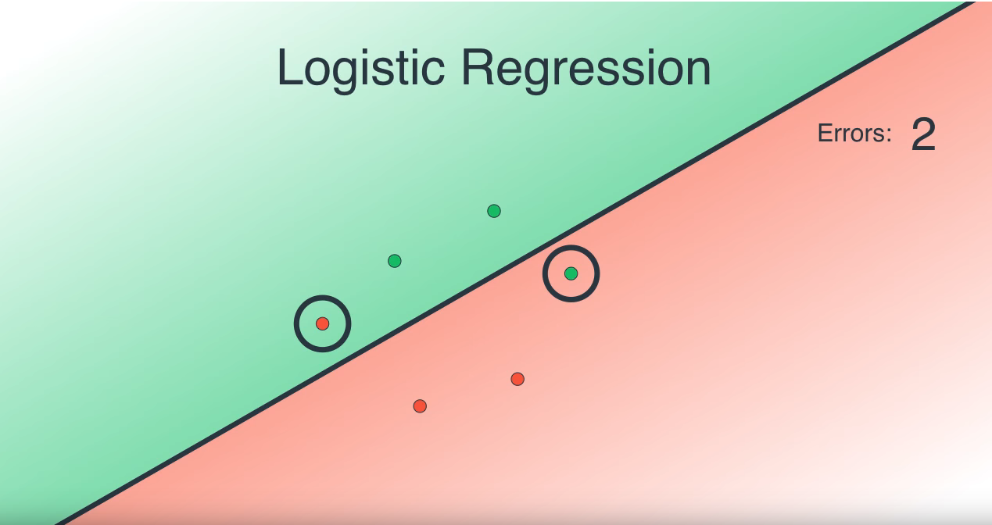
Logistic Regression

Slide 40
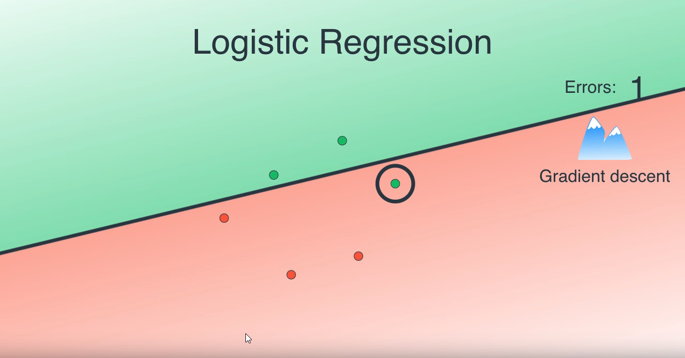
Logistic Regression

Slide 41
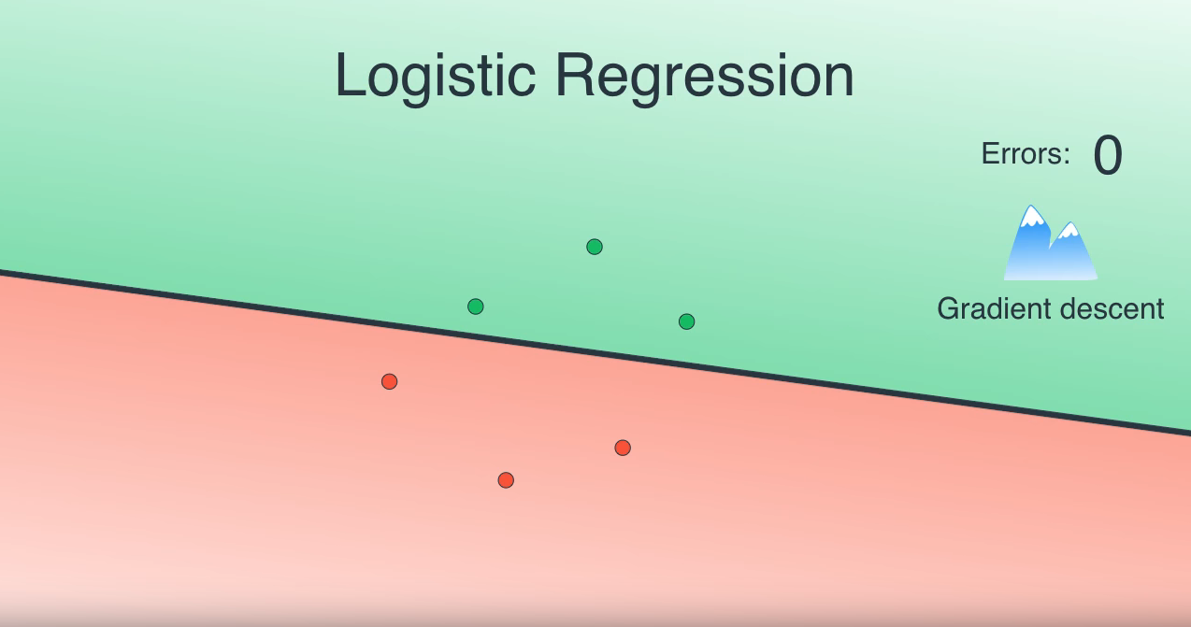
Logistic Regression

Slide 42
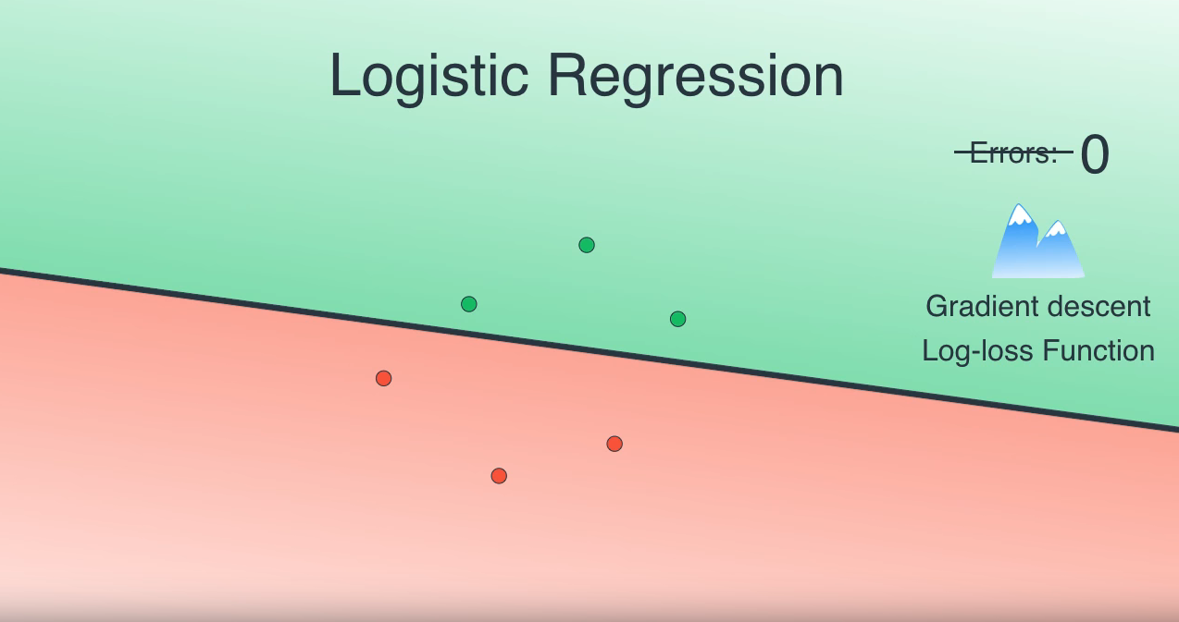
Logistic Regression

Slide 43
Example

Slide 44
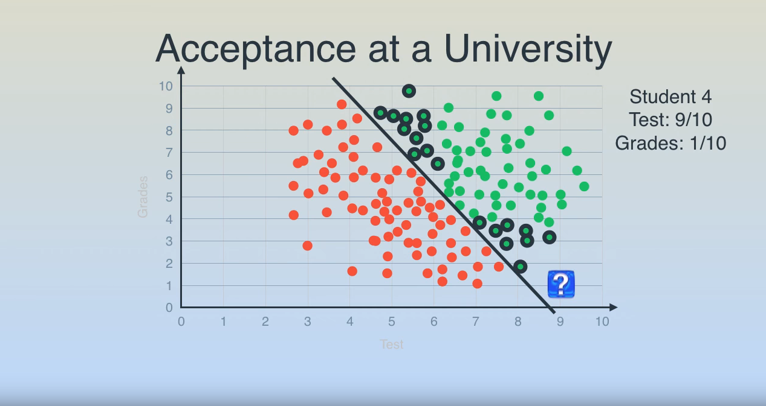
Example

Slide 45
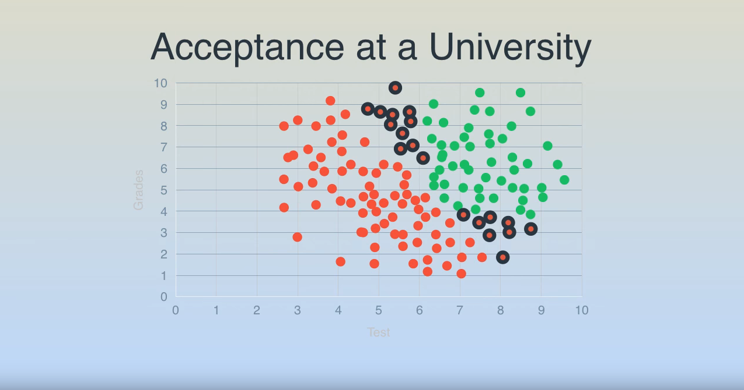
Example

Slide 46
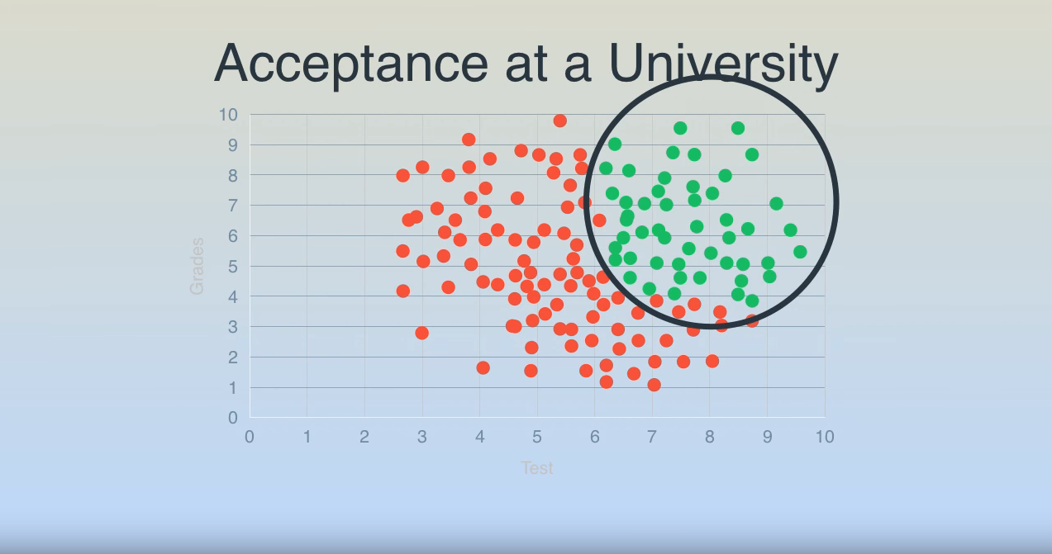
Example

Slide 47
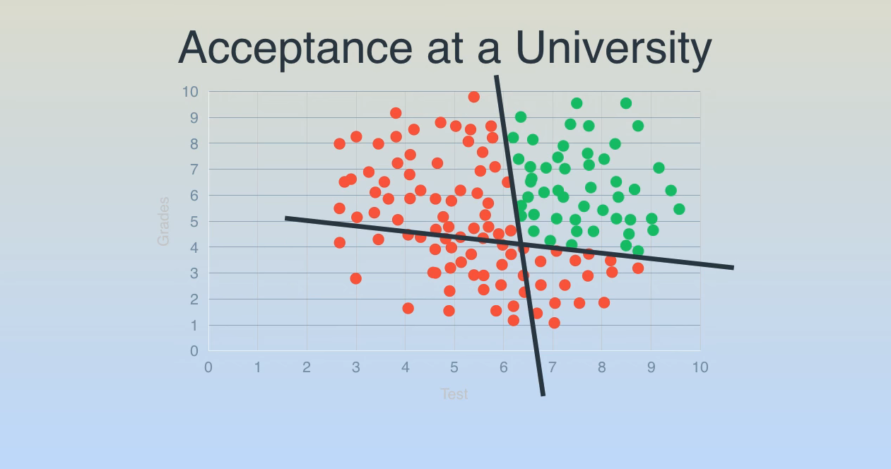
Example

Slide 48
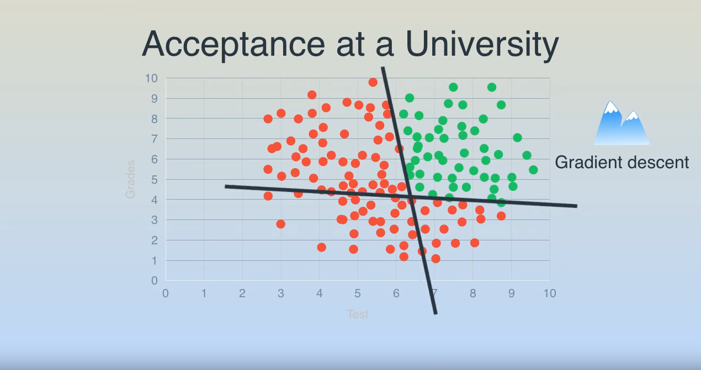
Example

Slide 49
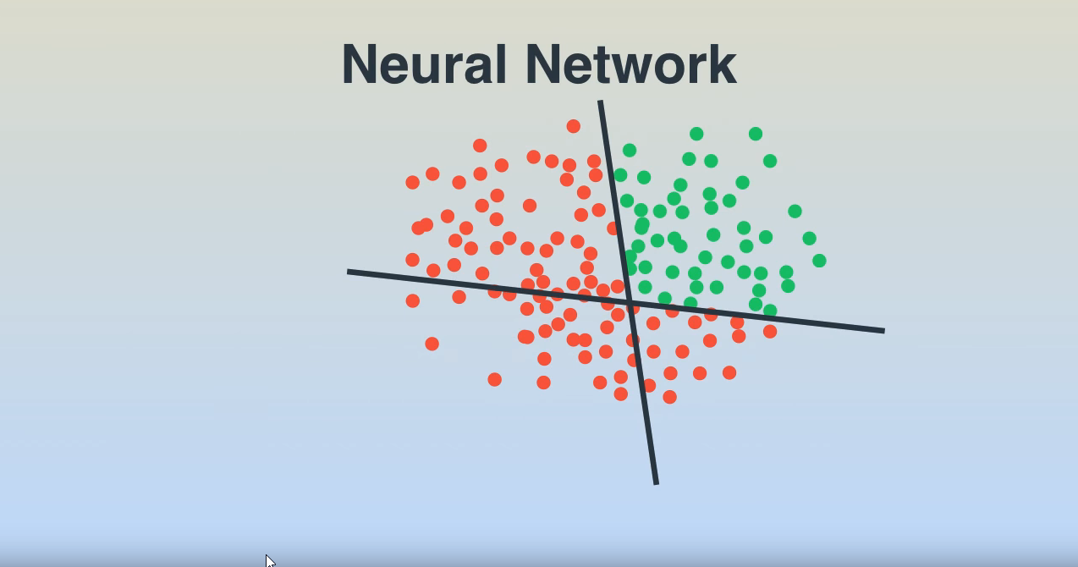
Example

Slide 50
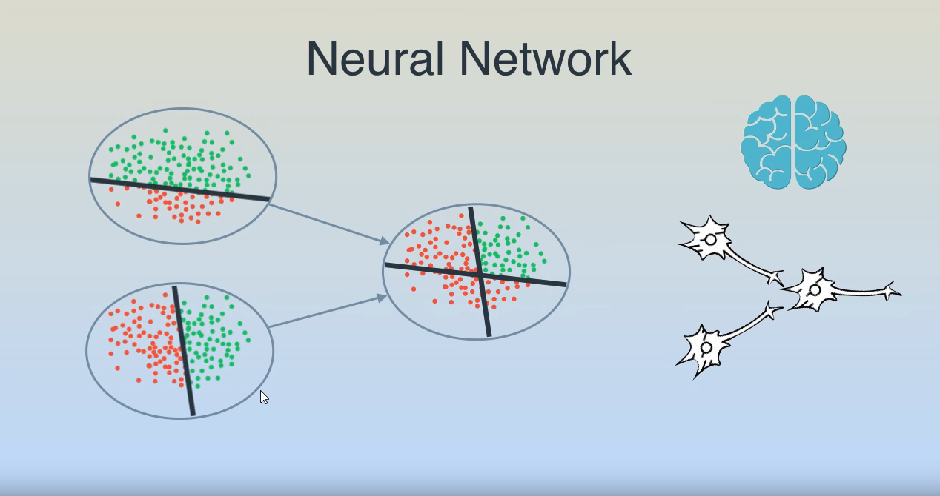
Example

Slide 51
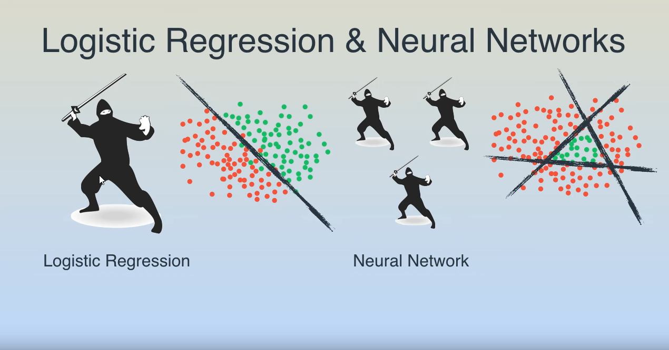
Example

Slide 52
Example

Slide 53
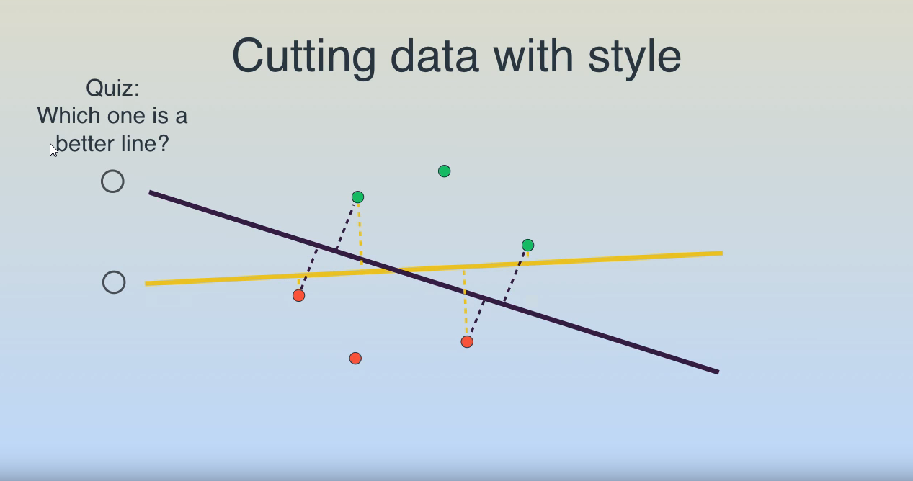
Example

Slide 54
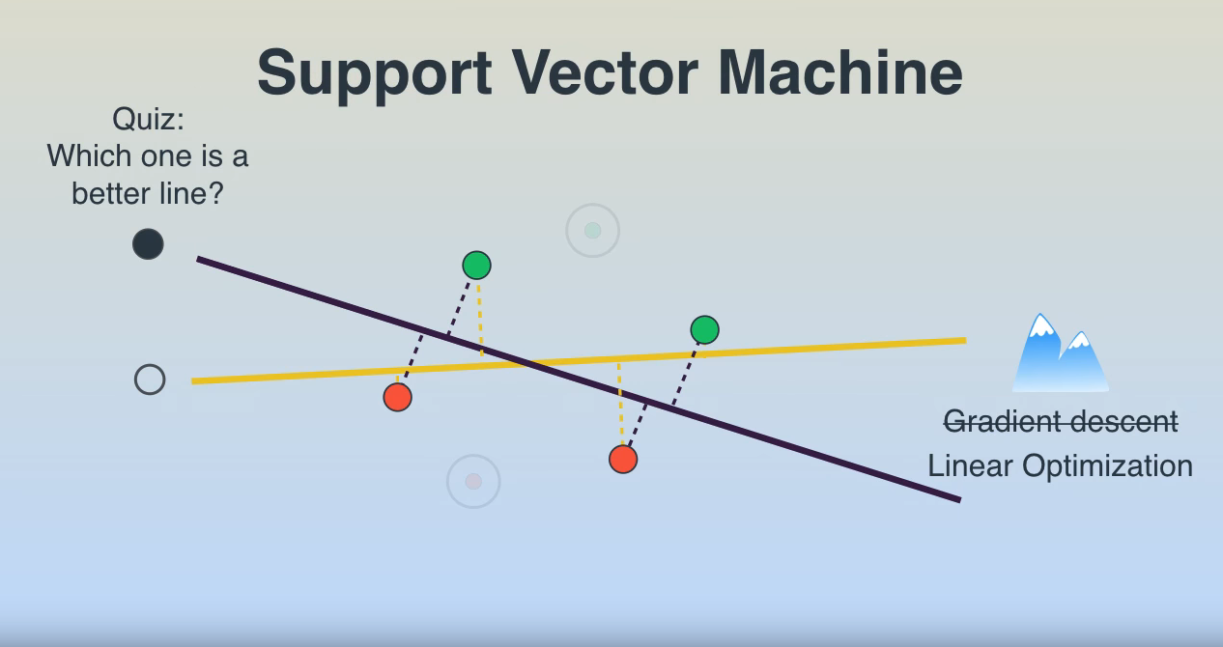
Example

Slide 55
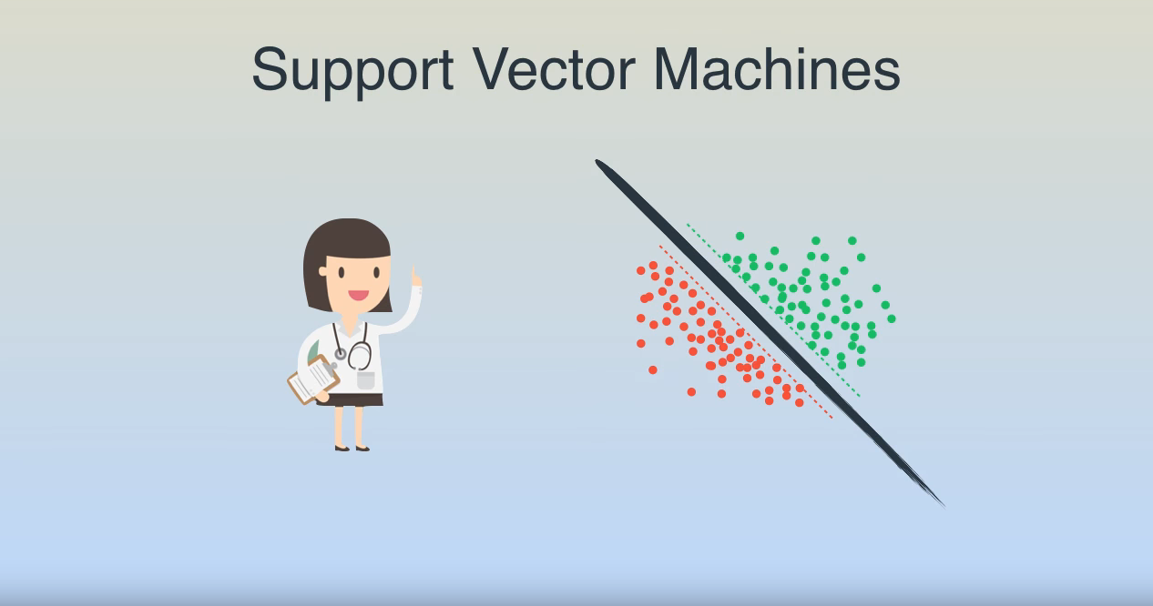
Example

Slide 56
Example

Slide 57
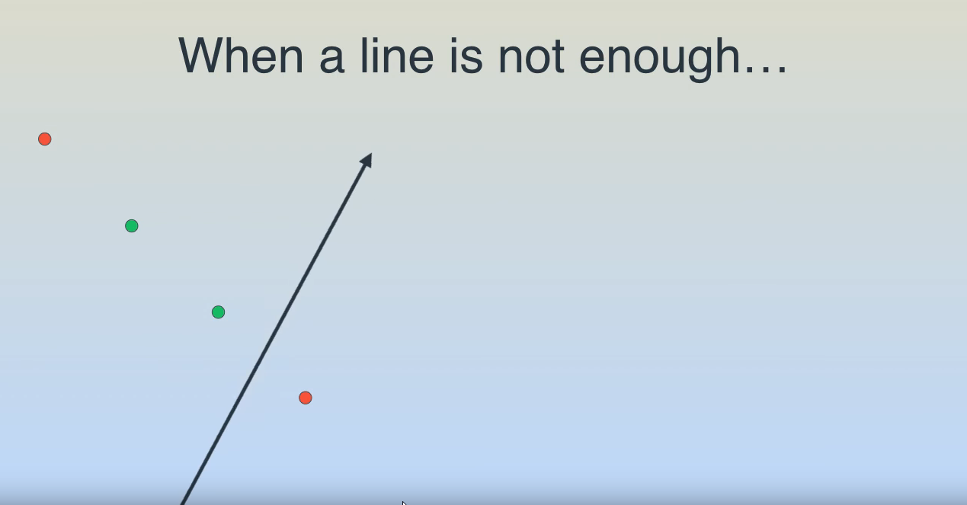
Example

Slide 58
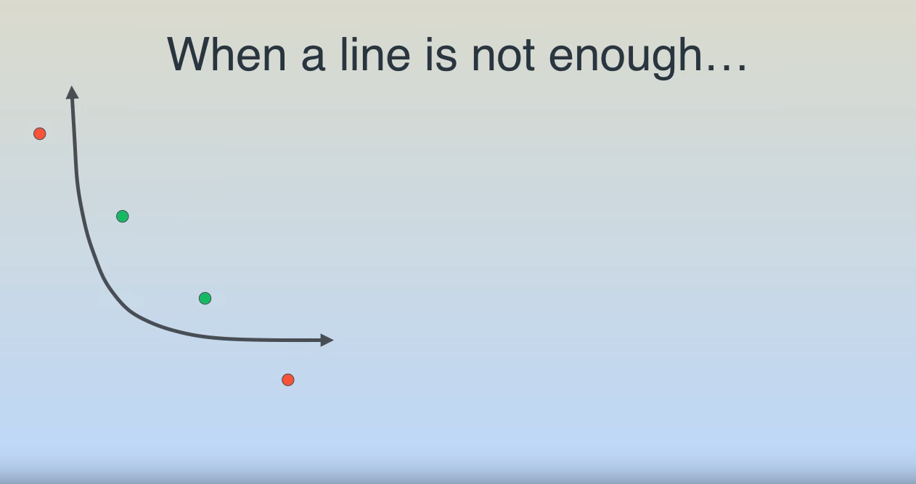
Example

Slide 59
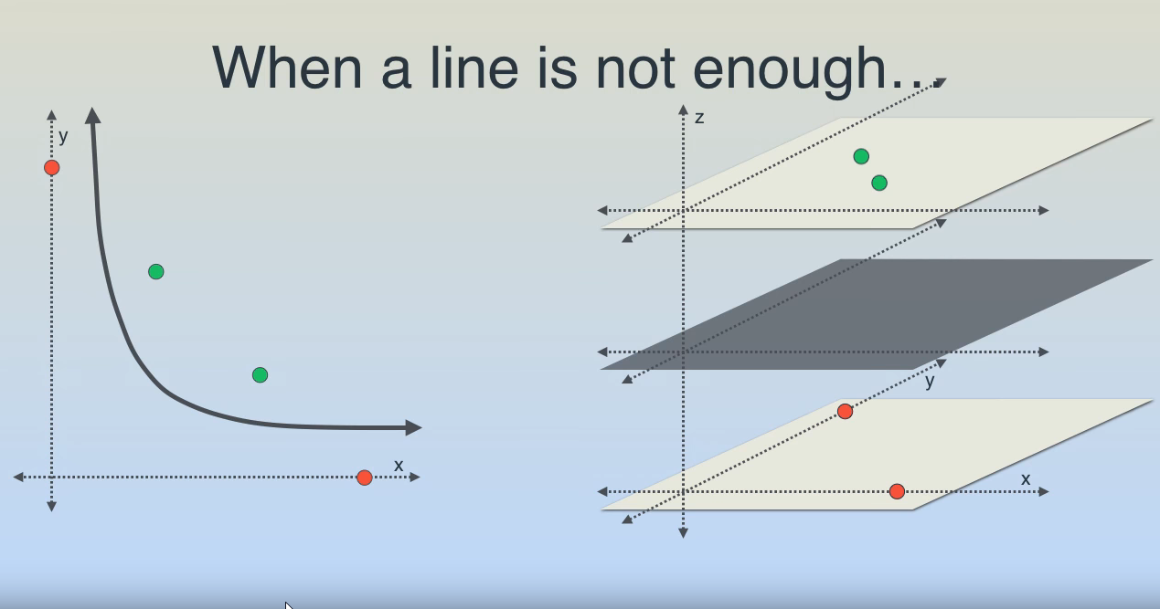
Example

Slide 60
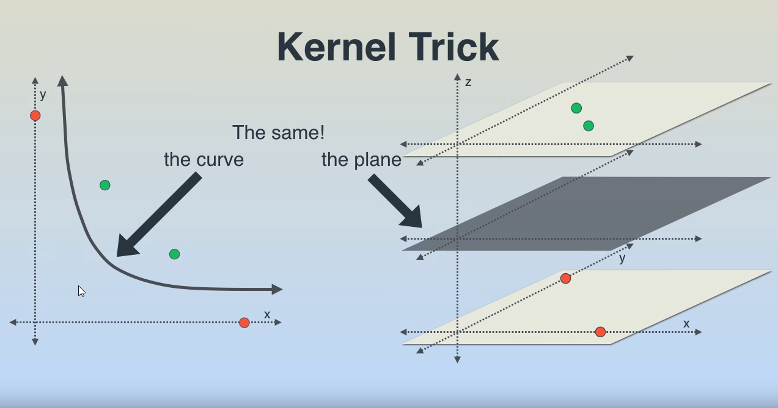
Example

Slide 61

Example

Slide 62

Example

Slide 63

Example

Slide 64

Example

Slide 65

Example

Slide 66

Example

Slide 67

Example

Slide 68
Example

Slide 69

Example

Slide 70

Example

Slide 71

Example

Slide 72

Example

Slide 73

Example

Slide 74

Example

Slide 75

Example

Slide 76

Example

Slide 77

Example

Slide 78

Example

Slide 79
Example

Slide 80

Example

Slide 81

Example

Slide 82

Example

Slide 83

Example

Slide 84

Example

Slide 85
Types of learning
Supervised Learning
Unsupervised Learning
Semi-supervised Learning
Reinforcement Learning

Slide 86

Types of learning

Slide 87

Supervised Learning

Slide 88
Supervised Learning
Classification
Regression

Slide 89
Supervised Learning
Analytical learning Artificial neural network Backpropagation Boosting (meta-algorithm) Bayesian statistics Case-based reasoning Decision tree learning Inductive logic programming | Gaussian process regression Group method of data handling Kernel estimators Learning Automata Learning Classifier Systems Minimum message length (decision trees, decision graphs, etc.) Multilinear subspace learning Naive bayes classifier | Maximum entropy classifier Conditional random field Nearest Neighbor Algorithm Probably approximately correct learning (PAC) learning Ripple down rules, a knowledge acquisition methodology Symbolic machine learning algorithms Subsymbolic machine learning algorithms Support vector machines | Minimum Complexity Machines (MCM) Random Forests Ensembles of Classifiers Ordinal classification Data Pre-processing Handling imbalanced datasets Statistical relational learning Proaftn, a multicriteria classification algorithm

Slide 90

Unsupervised Learning

Slide 91
Unsupervised Learning
Clustering
Association

Slide 92
Unsupervised Learning
clustering
k-means
mixture models
hierarchical clustering,^{[2]}
anomaly detection
Neural Networks
Hebbian Learning
Generative Adversarial Networks
Approaches for learning latent variable models such as
Expectation–maximization algorithm (EM)
Method of moments
Blind signal separation techniques, e.g.,
Principal component analysis,
Independent component analysis,
Non-negative matrix factorization,
Singular value decomposition.^{[3]}

Slide 93

Reinforcement Learning

Slide 94
Regression Algorithms | Linear Regression Logistic Regression Stepwise Regression | Clustering Algorithms | k-Means clustering k-Medians Expectation Maximization (EM)
Classification Algorithms | Linear Classifier Support Vector Machine (SVM) Kernel SVM Sparse Representation-based classification (SRC) | Artificial Neural Network Algorithms | Perceptron Softmax Regression Multi-layer Perceptron Back-Propagation
Instance-based Algorithms | k-Nearest Neighbor (kNN) Learning Vector Quantization (LVQ) | Dimensionality Reduction Algorithms | Principal Component Analysis (PCA) Linear Discriminant Analysis (LDA)
Regularization Algorithms | Ridge Regression Least Absolute Shrinkage and Selection Operator (LASSO) Least-Angle Regression (LARS) | Ensemble Algorithms | Boosting AdaBoost Random Forest
Bayesian Algorithms | Naive Bayes Gaussian Naive Bayes

Slide 95


Slide 96


